Slide 1


DEPARTMENT OF COMPUTER SCIENCE AND ENGINEERING
20CS7503 & DESIGN PROJECT 3
END SEMESTERPRACTICAL EXAMINATION-NOV /DEC 2025
REVIEW PRESENTATION
Batch No.: 5
Date: /11/2025
Session: AN

Slide 2
EARLY DETECTION OF GENETIC DISORDERS IN FETUSES
USING MACHINE LEARNING
Guide Name: Mrs.S.Sujitha ,M.E.
Team Members: B.Sudeesh(811722104160)
B.Sundar(811722104161)
J.Sundar Prasath(811722104162)

Slide 3
OBJECTIVE OF THE PROJECT
To develop a machine learning model that integrates ultrasound images and patient data.
To accurately classify genetic disorders such as Down Syndrome, Turner Syndrome, etc.
To simulate realistic diagnostic conditions by handling inconsistent or missing image data.
To provide a flexible system where images and tabular data can be manually uploaded.
To improve clinical decision-making in fetal and genetic disorder screening.

Slide 4
INTRODUCTION
Genetic disorders in fetuses can cause severe health complications if not detected early.
Traditional detection methods are invasive and risky for both mother and baby.
Machine learning enables non-invasive and accurate prediction using medical data.
The project integrates ultrasound images and patient information for early disorder detection.
This system supports doctors in making faster and safer prenatal diagnostic decisions.

Slide 5
LITERATURE SURVEY
TITLE OF PAPER | AUTHOR(S) | PAPER GIST | TECHNOLOGY USED
Accuracy and AI Models Generalization in Medical | Computers, Materials & Continua (2025) | Machine learning-based convolutional neural network model to identify complex genetic disorders using patient data relationships. | Used Convolutional Neural Network , Decision Trees, and Feature Correlation for genetic prediction.
Prediction of Genetic Disorders using Machine Learning | International Journal of Innovative Science and Research Technology (2023) | Developed ML classifiers for detecting hereditary disorders based on medical history and clinical parameters. | Used SVM, Random Forest, and Logistic Regression for classification and pattern analysis.
Prenatal Genetic Diagnosis and Screening | International Journal of Science and cTechnology (2023) | Detecting hereditary disorders based on medical history and clinical parameters | Used SVM, Random Forest, and Logistic Regression for classification and pattern analysis.

Slide 6
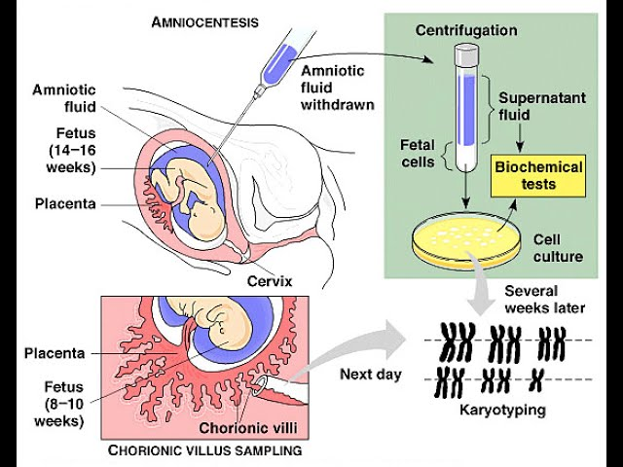
EXISTING SYSTEM ARCHITECTURE

Slide 7
PROBLEM IDENTIFICATION
Ultrasound accuracy depends heavily on the technician’s expertise.
Subtle genetic disorder markers may be missed by the human eye.
No existing system specifically focuses on ultrasound-only deep learning-based genetic disorder detection.
Traditional methods are invasive and not suitable for frequent screening.
A non-invasive, image-based automated system is needed to support clinicians.

Slide 8
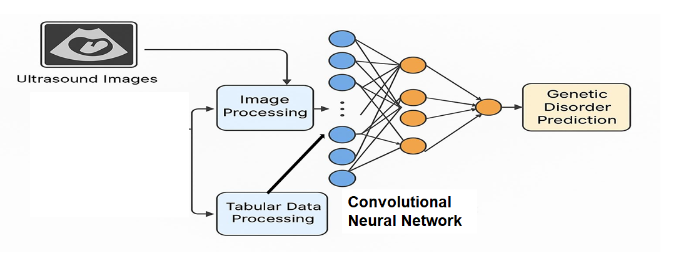
PROPOSED SYSTEM ARCHITECTURE

Slide 9
SOFTWARE AND HARDWARE REQUIREMENTS
HARDWARE
Processor: Intel Core i5 or higher
RAM: Minimum 8 GB (recommended 16 GB for model training)
Storage: At least 500 GB HDD or 256 GB SSD
Graphics: NVIDIA GPU (optional but improves deep learning performance)
Display: Standard monitor with 1280×720 resolution or above
SOFTWARE
Operating System: Windows 10
Programming Language: Python 3.8 or above
Libraries & Tools:TensorFlow / Keras ,NumPy, Pandas, OpenCV, Scikit-learn, Matplotlib
IDE / Platform: Jupyter Notebook or PyCharm
Database / File Format: CSV for patient data storage and output reports

Slide 10
MODULES
Data Preparation
Feature Extraction
Model Training
Disorder Prediction
Report Generation

Slide 11
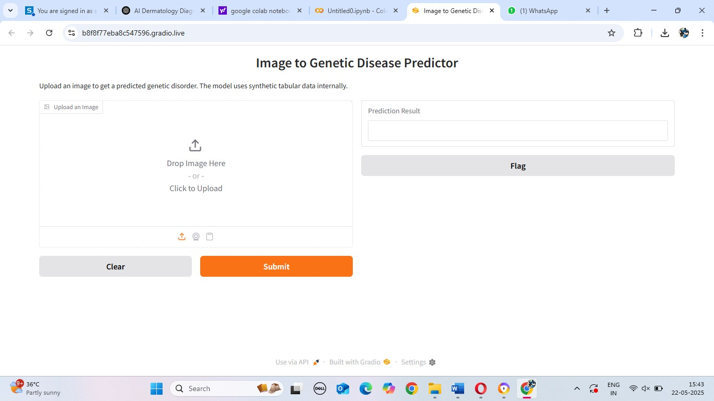
IMPLEMENTATION OF MODULE-1
Collect ultrasound images (PNG/JPG).
Organize images based on labeled disorder categories.
Resize and normalize images for model compatibility.
Split data into training, validation, and testing sets.

Slide 12
IMPLEMENTATION OF MODULE-2
Convert images to grayscale or keep 3-channel format.
Normalize pixel values to 0–1.
Apply augmentation like Rotation,zoom,shift,flip
brightness adjustment
Increases dataset size and improves learning stability.

Slide 13
IMPLEMENTATION OF MODULE-3
Build a CNN model (e.g., VGG16 / custom CNN).
Convolution layers extract edges, shapes, and intensity patterns.
Pooling layers reduce dimensionality and focus on key features.
Fully connected layers learn deeper patterns related to genetic markers.

Slide 14
IMPLEMENTATION OF MODULE-4
Final dense layers classify images into disorder categories.
Softmax activation used for multiclass output.
Track accuracy and loss during training.
Hyperparameters: learning rate, batch size, epochs, dropout.

Slide 15
IMPLEMENTATION OF MODULE-5
Accuracy and loss curves are plotted for visual analysis of model training.
Predicted results are organized in tabular format for each patient.
Summary includes input features and corresponding predicted disorder.
Future upgrades may include a GUI dashboard for hospital integration.

Slide 16
CONCLUSION
This project demonstrates a non-invasive and image-based approach for detecting fetal genetic disorders using deep learning.
By using only ultrasound images, the system reduces dependency on additional patient data and invasive prenatal procedures.
The CNN-based approach effectively learns visual markers associated with syndromes and supports doctors with more accuratedecision-making.
The results prove the potential of ultrasound-only AI models in prenatal diagnosis.

Slide 17
FUTURE ENHANCEMENTS
Increase dataset size with diverse ultrasound images.
Integrate advanced CNN models like EfficientNet or Vision Transformers.
Develop real-time ultrasound scan detection in clinics.
Build a mobile or web interface for easy upload and prediction.
Add heatmap visualization to show which image regions influenced the prediction.

Slide 18
THANKYOU

